Slide 1
JPA Project
Last Updated 4/11/2017 11:11 AM

Slide 2
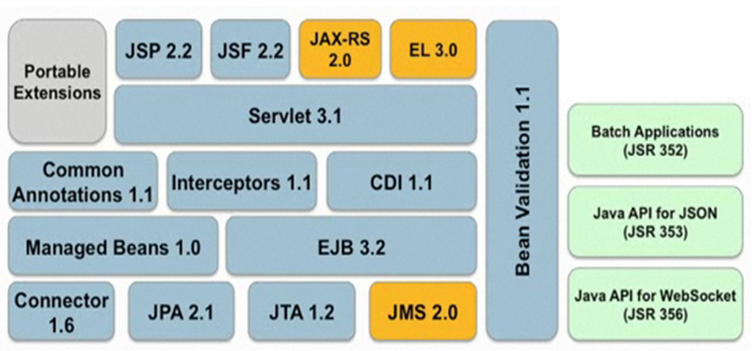
What is Java Persistence API
JPA is the Object-Relational Mapping (ORM) and Persistence Management interface of the Java EE 5.0 platform.
As part of the EJB 3.2 specification effort, it is supported by all major vendors of the Java technologies.

Slide 3
JPA Features
POJO Persistence : The framework provides for the persistence of Plain Old Java Objects.
Annotation-based Configuration of Object-Relational Mapping.
Annotations placed into persistent entity classes describe the mapping of classes to tables, attributes to columns, associations to FK relations, etc.
Implements standard OOAD associations with FK relations.
One-One / One-Many / Many-Many associations are automatically translated to FK relations.
Extended Query Language: ORM substitution for SQL.
Notes:
Plain Old Java Objects

Slide 4
JPA and Hibernate
Hibernate is a successful ORM technology that pre-dates the JPA standards.
Hibernate’s success motivated the shift from the older and much hated JEE Entity Beans.
JPA is a standard and API which is closely modeled after Hibernate’s original design.
We will be working with Hibernate’s implementation of JPA.
There are several other implementations e.g. EclipseLink ^{(1),} Apache OpenJPA, Oracle TopLink, and others.
Notes:
1 - See https://en.wikipedia.org/wiki/Java_Persistence_API

Slide 5
JPA Major Components
EntityManager: This class is the interface to JPA services.
Permits the CRUD of entity object instances.
Performs Transaction Management.
Executes JPA Query Language (JPQL) and Standard SQL stmts.
Several other less important services.
JPA Annotations
Annotations to be embedded in persistent entity classes.
Describes the mapping of classes to tables.
Describes relational constraints such as UNIQUE, etc.
Describes the associations between entities i.e. 1-1, 1-N, N-M, etc.

Slide 6
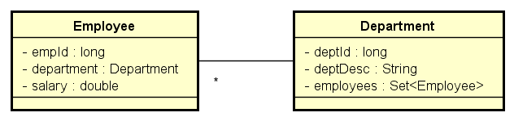
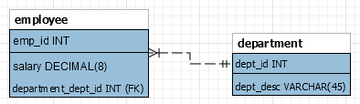
Example OR Mapping
Employee OOAD & ERD
Note the bi-directional relationship between Employee and Department.

Slide 7

Plain Old Java Objects (POJO) AKA Java Beans
JPA is able to persist POJOs
No special subclass or interfaces needed for persistent classes.
Entity classes should provide:
A default, no-arguments constructor.
Getter / Setter methods for each of its private attributes.
With the proper annotations, JPA will automatically generate the ORM to persist both the entities and the associations between entities.

Slide 8
Entity Class Annotations
The entity class (Department.java) annotations mark the class as a persistent entity.
@Entity
@Table(name = "department")
public class Department
{
private Long id;
…
The @Entity annotation signifies that the class is persistent.
The @Table annotation names the table and is optional.
The same @Entity annotations are found in the Employee entity class.

Slide 9
Department Annotations
Entity class attributes are annotated to describe them as IDs (primary keys) and their associations with other entities.
@Id
@GeneratedValue(strategy = GenerationType.IDENTITY)
public Long getId() {
…
@Id annotation marks the attribute as the entity’s primary key.
@GeneratedValue annotation signifies that the key will be generated by the DBMS i.e. auto-increment column.

Slide 10
Employee-Department Association
The Employee 1-N side of the association:
@ManyToOne(fetch=FetchType.EAGER)
@JoinColumn(name="dept_id", unique=false)
public Department getDepartment()
{
The name attribute names the FK column to be added to implement the 1-N association between department and employee.
The Department N-1 side of the association :
@OneToMany(fetch=FetchType.LAZY, mappedBy="department")
public Set<Employee> getEmployees()
{
The mappedBy attribute describes the mapping attribute on the opposite side of the relation ship e.g. Employee.department.

Slide 11
Employee-Department Association
Describing the 1-N association between Department and Employee.
The @ManyToOne() and @OneToMany() annotations are placed in their respective entity class.
Each annotation is associated with the associated attribute.
@ManyToOne is placed on Employee.department.
@OneToMany is placed on Department.employees

Slide 12
Bi-Directional Navigation Between Employee and Department
Employee and Department share 1-N bi-directional navigation.
Employees can reach their Department
Departments maintain a collection of their Employees.
This model supports bi-directional association through…
Department reference on Employee.
Set<Employee> references on Department.

Slide 13
Association FetchType
The fetch attribute describes when associated objects will be retrieved from the database.
FetchType.EAGER will cause the associated objects to be copied from the DB when the owning object is copied.
When retrieving an Employee from the database, its associated Department will also be retrieved.
FetchType.LAZY will cause the associated objects to be copied from the DB when referenced from the owning object i.e. on demand.
When retrieving a Department from the database, its collection of Employees will be copied on demand as the collection is accessed.
FetchType.LAZY is used to reduce the overhead of retrieving a large number of objects when fetching the owning object.

Slide 14

@Column Annotation
@Column, is put on a class variable’s getter method.
Describes the mapping of the attribute to table column.
Has several options:
Updatable (boolean)
Nullable (updatable)
Length (int)

Slide 15
@Column Annotation
The @Column annotation is not needed if the default mapping of class attribute to table column is sufficient.
The auto-generated schema will generate tables columns.
In most cases, the default OR mapping is sufficient for a non-mapping attribute.
This is why most of the object attributes are not annotated in the example code.
In other cases, we need to identify optional parameters to get the mapping semantics needed by the requirements.

Slide 16
@Column Annotation
There are 4 types of supported associations:
@OneToOne
@OneToMany
@ManyToOne
@ManyToMany
Both one-way and bi-directional navigation can be supported across 1-1, 1-N, & N-1 associations.
Association fetch type can be defined as Lazy and Eager
AKA “Loading Strategy”.

Slide 17
@OneToOne Associations
The project schema maintains several 1-1 associations.
Between Customer and Address / CreditCard.
Between Purchase and Product / Customer.
Only the attribute on the “owning” side of a 1-1 relationship needs to be annotated.
In the owning Customer class.
@OneToOne(fetch = FetchType.EAGER, cascade = CascadeType.ALL)
public Address getAddress()
{ }
@OneToOne(fetch = FetchType.EAGER, cascade = CascadeType.ALL)
public CreditCard getCreditCard()
{ }
No annotations are required on the “owned” class (Address) in a 1-1 relationship.

Slide 18
Configuring JPA
A file “persistence.xml” is used to describe the persistence for an application.
persistence-unit is the XML element that described a the connection, classes, etc. typically for an application.
The persistence-unit describes:
The DBMS connection.
Entities to be persisted.
Other configuration information.

Slide 19
Persistence.xml
Persistence Unit Name
JDBC URL
DBMS ID & Password
<persistence-unit name="jpa-employee" transaction-type="RESOURCE_LOCAL">
<provider>org.hibernate.jpa.HibernatePersistenceProvider</provider>
<properties>
<property name="javax.persistence.jdbc.url" value="jdbc:mysql://localhost/employee" />
<property name="javax.persistence.jdbc.user" value="root" />
<property name="javax.persistence.jdbc.password" value=“xxx" />
<property name="javax.persistence.jdbc.driver" value="com.mysql.jdbc.Driver" />
<property name="hibernate.show_sql" value="false" />
<property name="hibernate.format_sql" value="true" />
<property name="hibernate.dialect" value="org.hibernate.dialect.MySQL5InnoDBDialect" />
<property name="hibernate.hbm2ddl.auto" value="update" />
<property name="hibernate.archive.autodetection" value="class, hbm" />
<!-- Configuring Connection Pool -->
<property name="hibernate.c3p0.min_size" value="5" />
<property name="hibernate.c3p0.max_size" value="20" />
<property name="hibernate.c3p0.timeout" value="500" />
<property name="hibernate.c3p0.max_statements" value="50" />
<property name="hibernate.c3p0.idle_test_period" value="2000" />
</properties>
</persistence-unit>
Debug Options
Schema Generation
Enable Annotations

Slide 20
Persistence Options
JPA / Hibernate can automatically generate and update a DBMS schema that supports the OR Mapping described by the application’s entity classes.
hibernate.hbm2ddl.auto configures schema generation.
Various debugging options are provided.
Integration with logging libraries with multiple levels of detail.
hibernate.show_sql will print the SQL executed on the DBMS.

Slide 21
EntityManager Methods
Create, commit, and rollback transactions
EM.getTransaction.begin()
EM.getTransaction.commit()
EM.getTransaction.rollback()
EM.find(Class, IDValue) where class is the entity’s class and id is the value of the entity’s ID attribute value.
EM.persist(Object) where object is the unattached object to be persisted in the DBMS.
EM.remove(Object) where object’s id value will be used to remove the entity from the DBMS.
EM.merge(Object) will merge a ‘detached’ object back into a persistence context i.e. associated with a table row.

Slide 22
Example: Create (Persist) Customer
public void create(EntityManagerFactory emf) {
// Obtain EntityManger
EnityManager em = emf.createEntityManager();
// Build Entity To Persist
Customer cust = new Customer();
cust.setName("Jonny Quest");
cust.setDOB("2/21/1955");
// Start Transaction
em.getTransaction().begin();
// Persist the customer
em.persist(cust);
// Commit Transaction
em.getTransaction().commit();
// Close EntityManager
em.close();
}

Slide 23
Example: Retrieve Customer by ID
public void retrieve(EntityManagerFactory emf) {
// Obtain EntityManger
EnityManager em = emf.createEntityManager();
// Start Transaction
em.getTransaction().begin();
// Find Customer by ID
long id = 1;
Customer cust = (Customer)em.find(Customer.class, id);
System.out.println("Customer Name " + cust.getName());
// Commit Transaction
em.getTransaction().commit();
// Close EM
em.close();
}

Slide 24
Example: Update Customer
public void update(EntityManagerFactory emf) {
// Obtain EntityManger
EnityManager em = emf.createEntityManager();
// Start Transaction
em.getTransaction().begin();
// Find Customer by ID
Customer cust = (Customer)em.find(Customer.class, 1);
// Update the entity state
cust.setDOB("2/21/1956");
// Persist New State When Committing Transaction
em.getTransaction().commit();
// Close EM
em.close();
}

Slide 25
Example: Delete Customer
public void delete(EntityManagerFactory emf) {
// Obtain EntityManger
EnityManager em = emf.createEntityManager();
// Start Transaction
em.getTransaction().begin();
// Find Customer by ID
Customer cust = (Customer)em.find(Customer.class, 1);
// Delete the customer
em.remove(cust)
// Commit Transaction
em.getTransaction().commit();
// Close EM
em.close();
}

Slide 26
Java Persistence Query Language
JPA provides its own DML substitute for SQL.
JPQL is a query language that is used to define select and joins between entities (tables).
Unlike SQL, JPQL describes its queries in terms of object attributes (not table columns).
See JPQL Docs
Notes:
Note that UTD engineering school students have access to O’Reilly Safari Online Library.
Their book on JPA/Hibernate is very good.

Slide 27
JPQL Features
JPQL provides most of the facilities offered by SQL.
A SELECT clause, which determines the type of the objects and values to be selected from the objects.
A FROM clause, which provides declarations that designate the class to which the expressions specified in the other clauses of the query apply.
An optional WHERE clause, which may be used to restrict the results that are returned by the query;
An optional GROUP BY clause, which allows query results to be aggregated in terms of groups;
An optional HAVING clause, which allows filtering over aggregated groups;
An optional ORDER BY clause, which may be used to order the results that are returned by the query.

Slide 28
JPQL Expressions
Select Customers by Zipcode:
from Customer as c where c.address.zipcode = :zip
Select Purchases made by Customer:
select from Purchase as p where p.customer.id = :customerID
Select Purchases made between two dates:
select from Purchase as p where p.purchaseDate between :start and :end
Note that these queries select and join by Java class attributes, not table columns.

Slide 29
Executing JPQL expressions
The JPA EntityManager provides a createQuery() method that is passed the JPQL query string.
public List<Customer> retrieveByZipCode(String zipCode) throws SQLException
{
List<Customer> customers = entityManager.createQuery( "from Customer as c where c.address.zipcode = :zip")
.setParameter("zip", zipCode)
.getResultList();
return customers;
}
Note the API is defined so that these three operations can be chained into a single compound statement.

Slide 30
JPQL Fun Facts
Supports inner and outer joins.
Uses LIKE to specify regex-like String matches.
Allows subqueries with IN, ANY, ALL, and other inclusion mechanisms.
Provides GROUP BY, ORDER BY, and HAVING.
Aggregate Functions: MIN, MAX, AVG, etc.
Other features provided by SQL.

Slide 31
Entity Management
Persistence Unit
A unit of persistence including database connection and the entity classes that can be persisted.
One or more persistence units are defined in a persistence.xml configuration file.
EntityManagerFactory
The EntityManagerFactory creates EntityManagers.
Each EMF is initialized with a PersistenceUnit.
Typically, every application maintains a single EMF.

Slide 32
Entity Management
EntityManager
Like a JDBC Connection but much more.
EntityManager is not thread safe.
Responsible for persisting and finding managed entity objects.
Caches managed entities read from database.
Manages transactions.
Executes JPQL statements.

Slide 33
Entity Management
Persistence Context
A context for holding persistent entity objects.
Each EntityManager maintains a single Persistence Context.
The EntityManager maintains (caches) persistent entities retrieved form the database.
If the same entity is fetched twice from the same EntityManager, the same instance (identity) will be returned.
If the same entity is fetched twice from the different EntityManager, two different instances (identity) will be returned.
The EM Persistence Context is cleared when the EM is closed.

Slide 34
Entity Object Lifecycle
The lifecycle of persisted objects consists of four states: New, Managed, Removed and Detached. See next slide.
A New Object has been created but not persisted.
A Managed Object has been persisted i.e. has a row in the table.
A Detached Objects is a persisted object that has been disconnected from its Persistence Context.
The Persistence Context is lost when the Transaction is committed / rolled-back¹or the EntityManager instance is closed.
A Removed Object has been marked for removal and will be deleted from the DBMS when the change is committed.
Notes:
1. See notes on next slide.

Slide 35
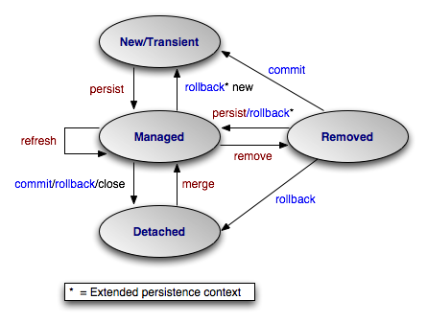
Managed Entity Object States

Slide 36
Detached Entities
A managed entity is attached to the database.
Its state reflects the current state of its entity table row.
Lazy-fetched associations will be retrieved on-access.
A managed entity becomes detached when its transaction is committed / rolled-back or its EM is closed.
Its state is detached from the state of its entity table row.
Lazy-fetched associations will generate an error on-access.
A detached entity can be reattached to the database using the EM.merge() method.

Slide 37
Steps to Implement JPA Project
Install Three Provided JPA (Hibernate) Projects
Customize persistence.xml
Update with DBMS Connection Information
Add Empty Schema to Database
Tables will be generated by JPA
Add JPA Annotations to Provided Entity Classes
Execute PopulateTables application
Verify tables built and rows added.
Implement Three Services (No DAOs)
Test Service Implementation with Provided Junit test cases.

